Slide 1
AI based motion control
2.18 Jin Lexuan

Slide 2
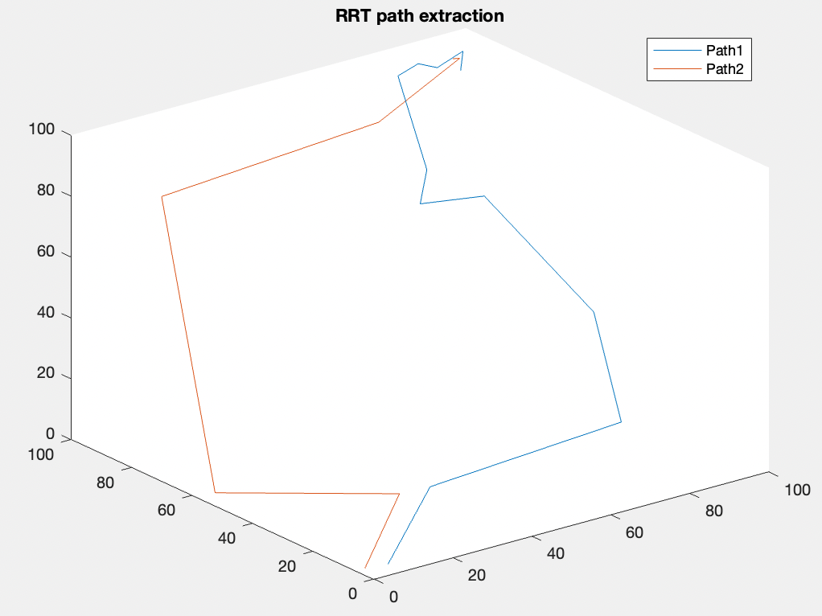
Path to Keypoint
There are two path generated by RRT in the picture. For each part, it is divided into several smaller path by keypoints(as 1,2,3,4,5...), according to the changing of direction.
In the previous version, I tried to let UAVs stop at each keypoint (velocity=0). This time I tried not to stop UAVs(keep a velocity) at keypoints
5
4
3
2
1

Slide 3

Transfer path to trajectory
Position $θ(t)=c_{0}+c_{1}t+c_{2}t^{2}+c_{3}t^{3}$
Speed $v(t)=c_{1}+{2c}_{2}t+3c_{3}t^{2}$
Accelaration $a(t)=2c_{2}+6c_{3}t$
Boundary conditions
derivation
 | Position | Velocity
t=0 | a | 0
t=T | b | 0

Slide 4
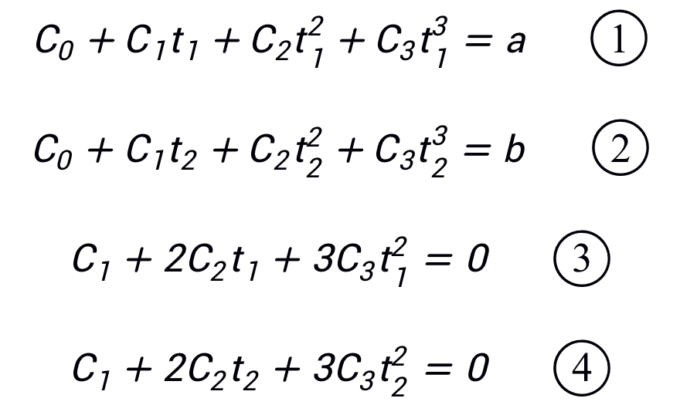
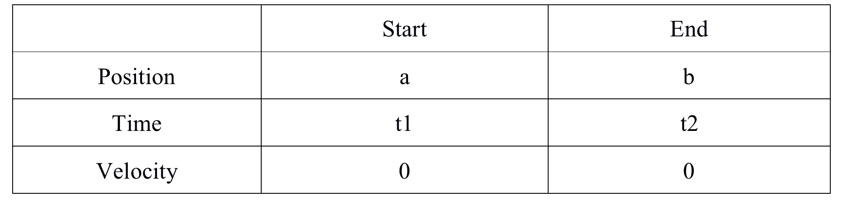
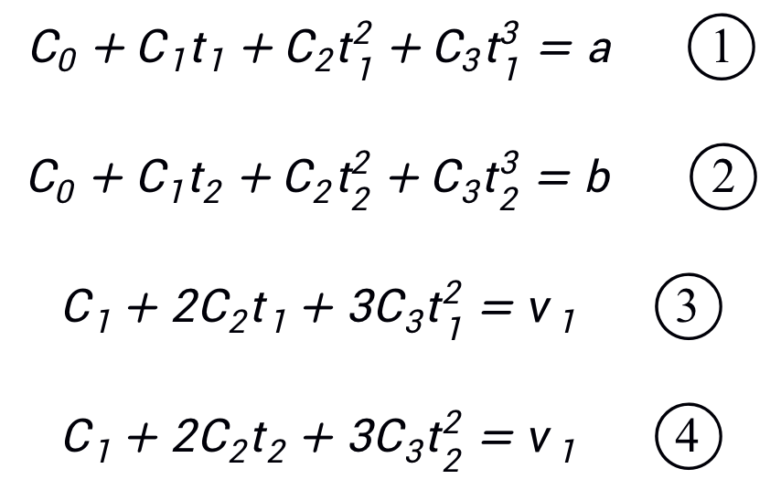
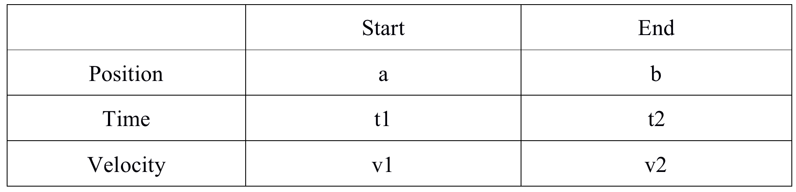
Change of equation condition

Slide 5
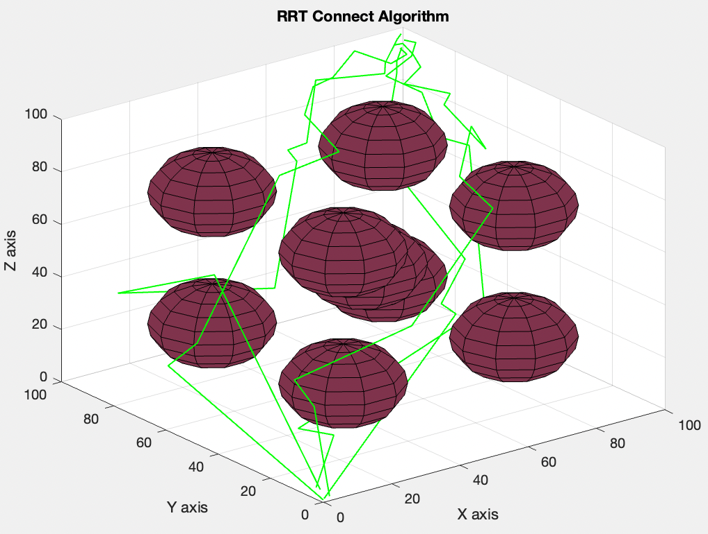
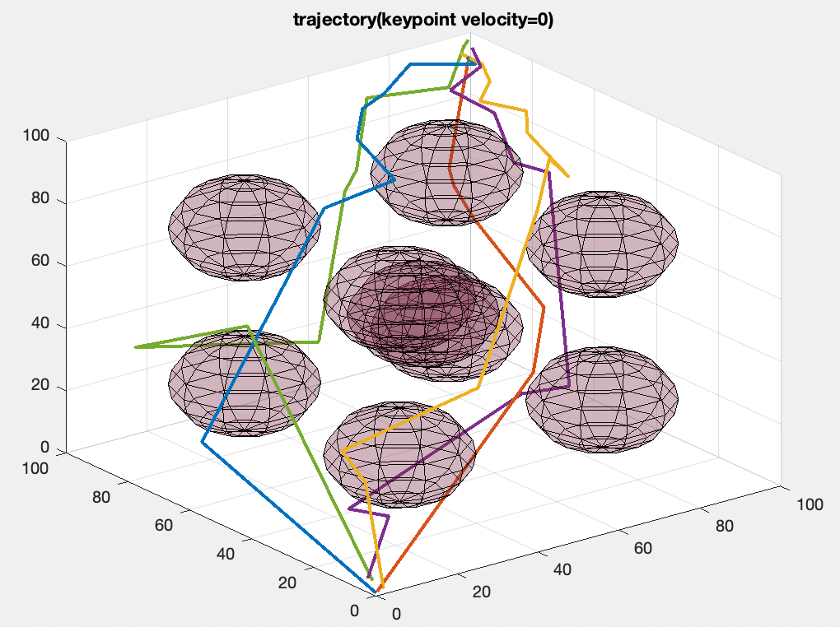
Path and initial trajectory

Slide 6
